Slide 1
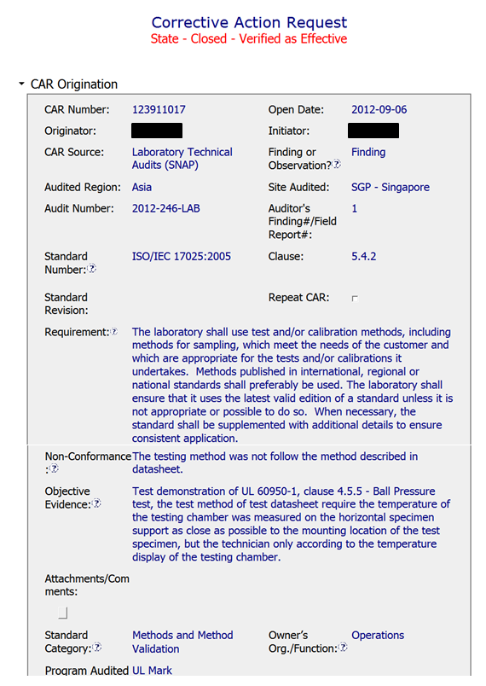
CAR 123911017
ORIGINATION
Requirement correctly identified.
NCR brief and to the point.
Objective Evidence: it’s clear tech used display rather than TC adjacent to the sample.
Correct Standard Category chosen.

Slide 2
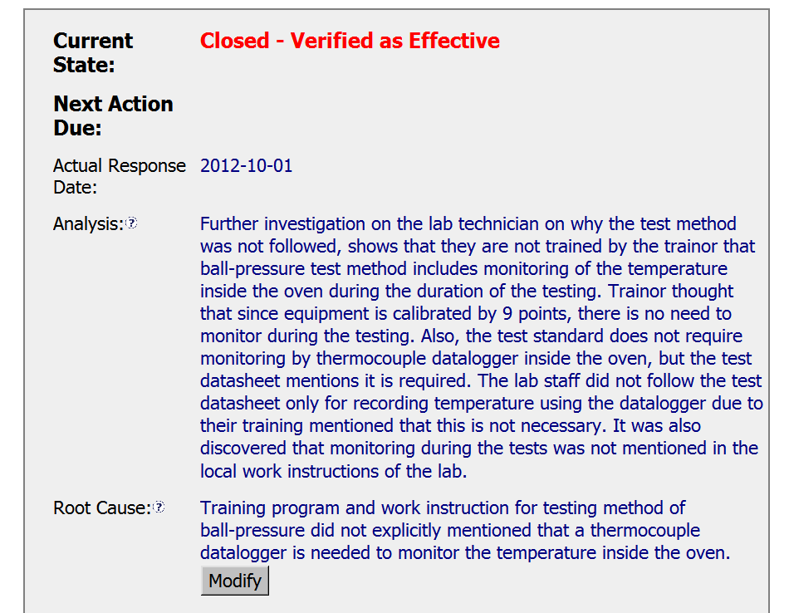
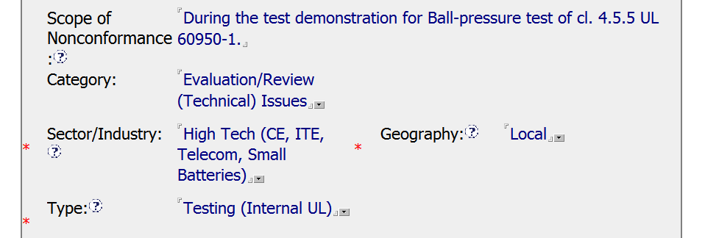
CAR 123911017
Good: Discusses inconsistencies between training, the test standard, datasheets, and local work instructions.
Improvement: Didn’t explore why there were inconsistencies, whether there were inconsistencies in other test methods, and whether this is more than just a local issue. Stakeholders not identified.
RESPONSE
Zeroes in on the inconsistencies between training and local work instructions verses the method in the datasheets, but does not address the inconsistency between the datasheets and the standard.
Since the Analysis didn’t address possible inconsistencies in other test methods or in other UL labs, focuses on the one test method from the Obj. Evidence conducted in the local lab.
RC Category ok. Probably could have also chosen “Training not Effective”.
Type of Process Impacted chosen correct.

Slide 3
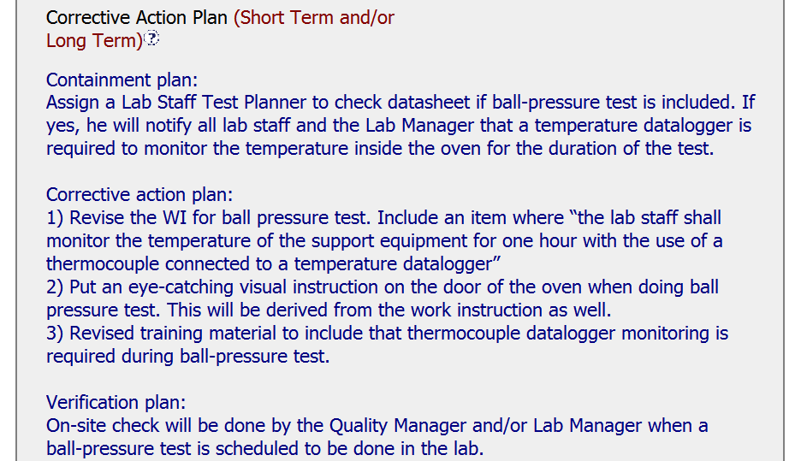
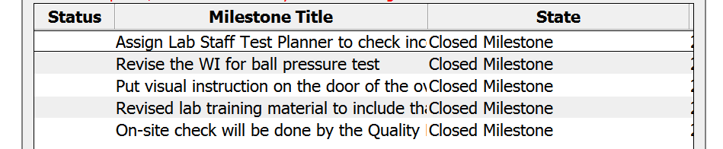
CAR 123911017
RESPONSE
Containment: Good short term fix.
Correction: Obj. Evidence was a test demonstration; therefore correcting the identified non-conformity was not necessary. Could have stated this in the CAP. Also, no evidence that possible past similar non-conformities of non-demonstration tests needed to be redone.
Corrective Actions: Address the inconsistencies between training and local work instructions verses the method in the datasheets. Flows well from RC.
Owner Verification: Good check on effectiveness of the CAs.
Milestones a direct reflection of the CAP.

Slide 4
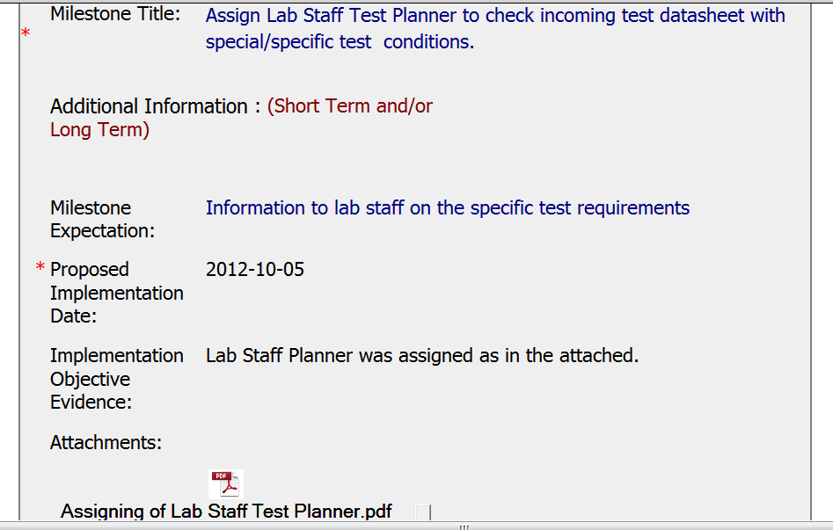
CAR 123911017
MILESTONE #1
Carried out as planned.

Slide 5
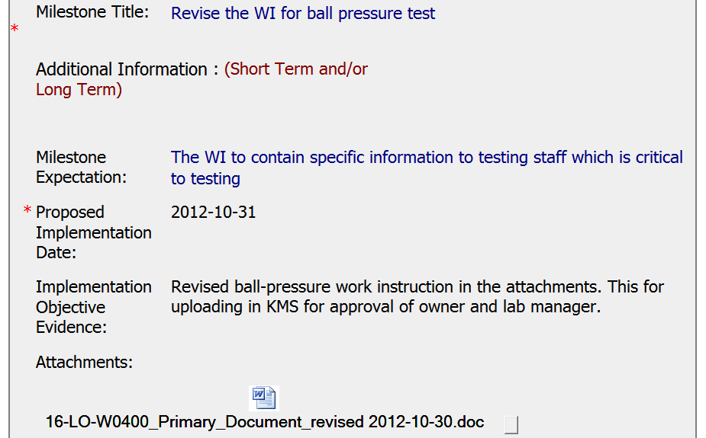
CAR 123911017
MILESTONE #2
Attached a draft of the revised WI. Milestone closed before evidence that the revised document had been published.

Slide 6
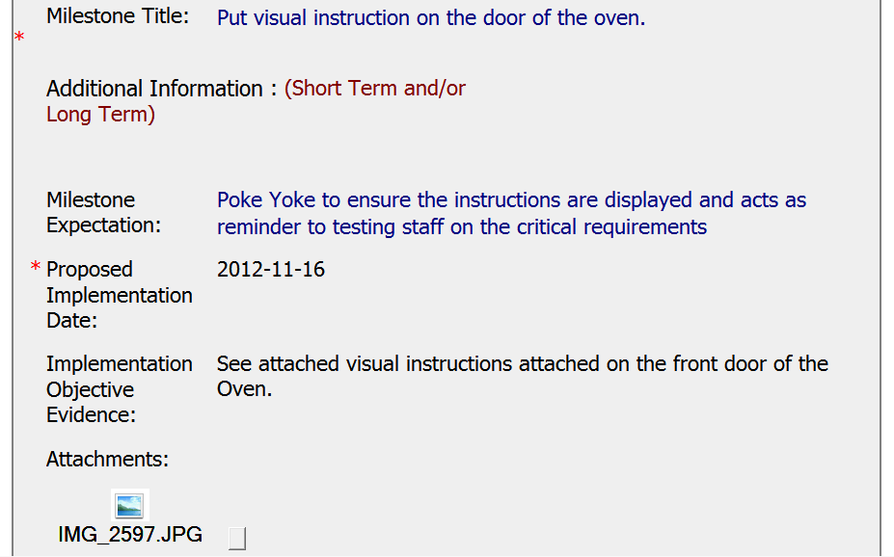
CAR 123911017
MILESTONE #3
Carried out as planned.

Slide 7
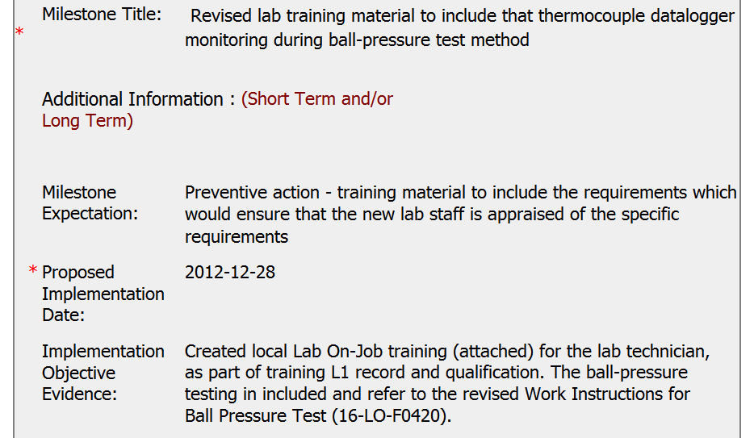
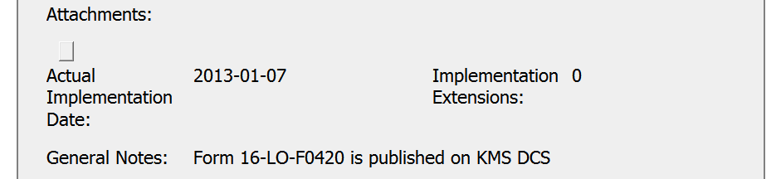
CAR 123911017
MILESTONE #4
A bit confusing here:
(1) Says Lab On-Job Training attached, but there are no attachments.
(2) Identifies the Work Instructions for the Ball Pressure Test as a Form.
(3) Says Form 16-LO-F0420 is published on KMS DCS, but can’t locate it in published docs.
(4) No evidence that training took place (e.g. no attendance sheets, etc. attached).

Slide 8
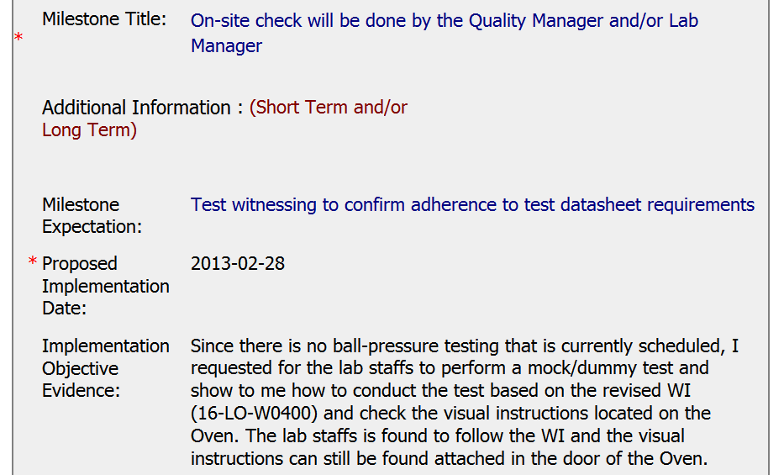
CAR 123911017
MILESTONE #5
Carried out as planned.

Slide 9
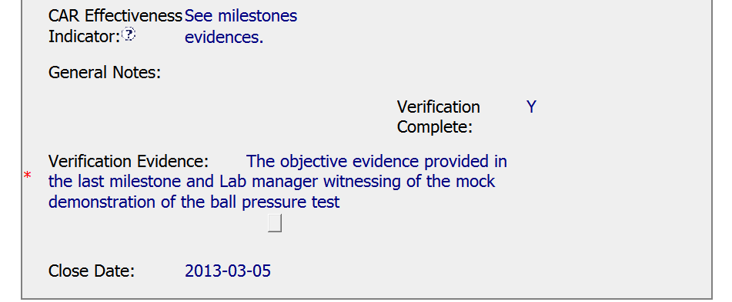
CAR 123911017
CORPORATE QA VERIFICATION
Owner Verification had to rely on a mock test. CAR Admin. could have waited a little longer for an actual test.

Slide 10
CAR #123911017 Analysis for CAR Calibration Meeting
J. Y. Lee
Taiwan QM

Slide 11
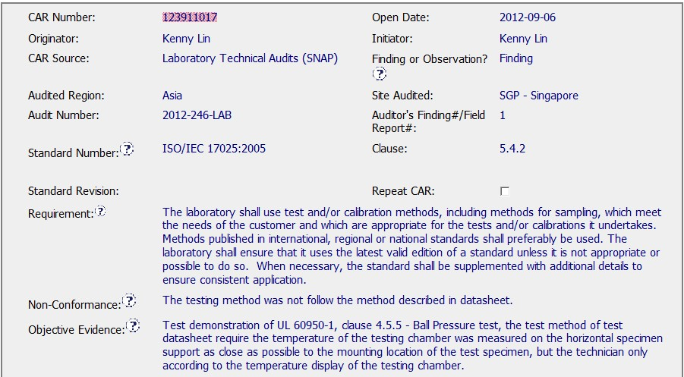
CAR #123911017
Info were all filled out
1
2
3
4
5
More complete if revision date added
6

Slide 12
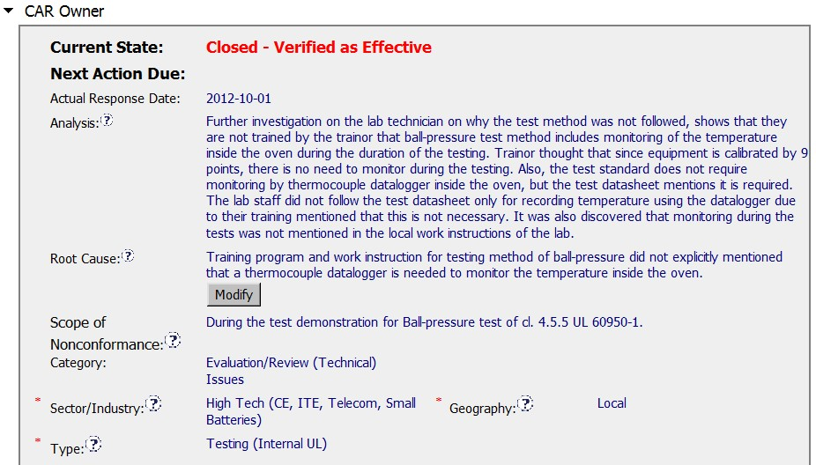
CAR #123911017
Something was wrong here: Follow datasheet or Standard? Which shall takes preference? Additional analysis shall be done to study why datasheet has undocumented requirements.

Slide 13
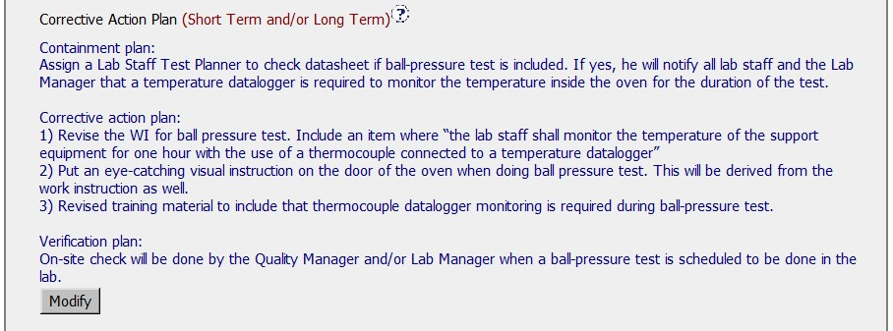
Datasheet shall be revised to follow standard requirement or just put datasheet additional temp point as optional
The other way around, if the datasheet shall be followed, then just follow. Why duplicate WI was created. Waste??
Besides above not too related comments, the action plan is very detailed and easy to understand

Slide 14
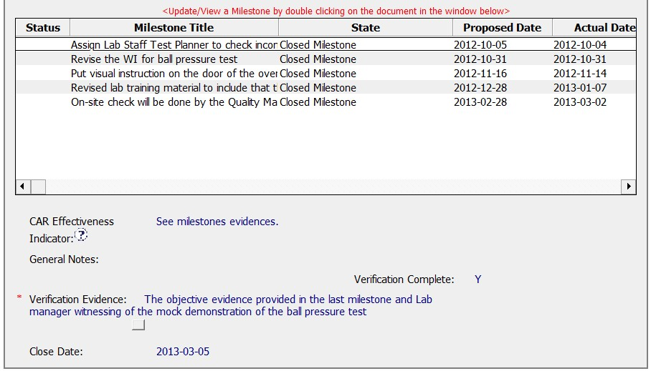
CAR #123911017
Milestones are well documented

Slide 15
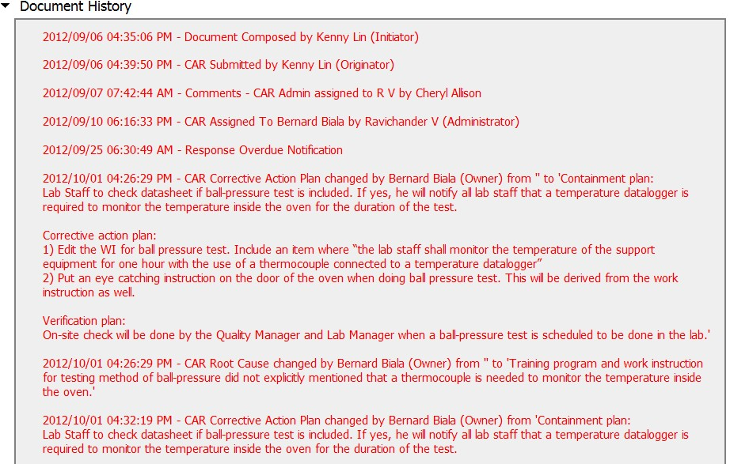
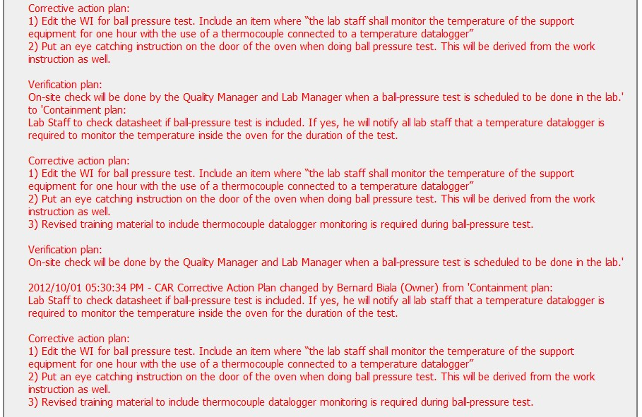

Slide 16
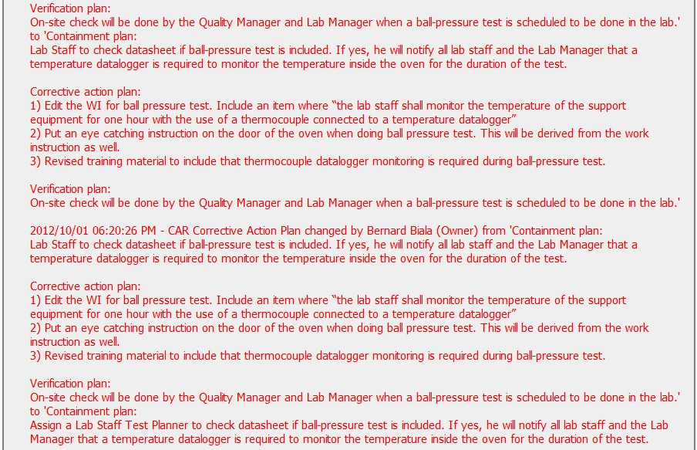
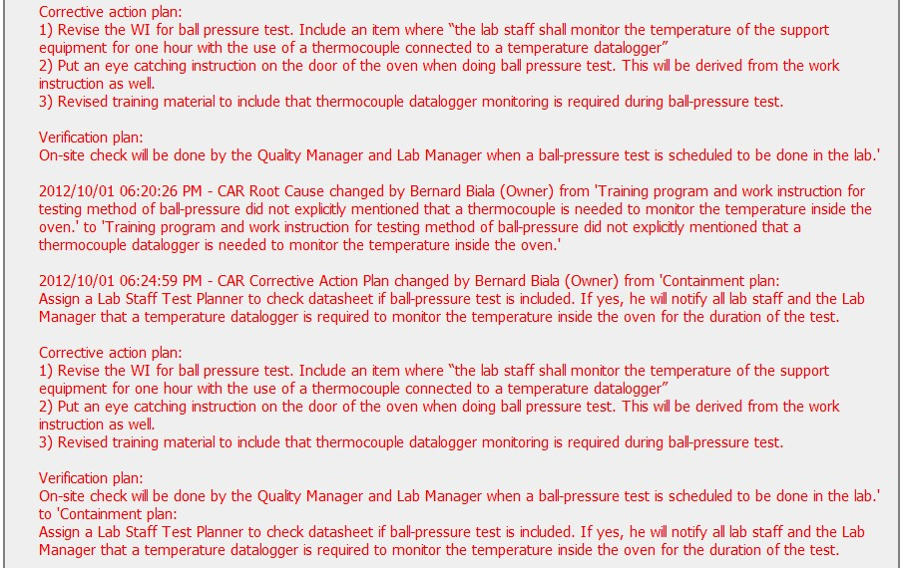

Slide 17
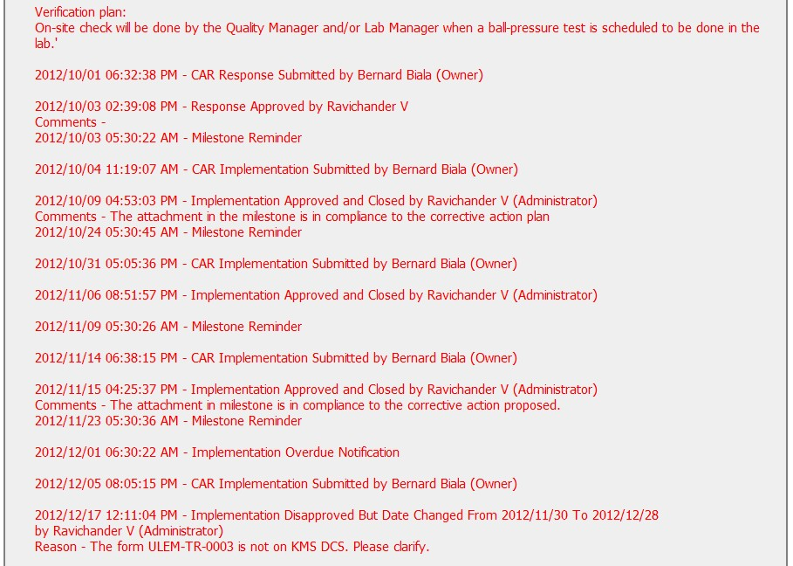
Over 9 days

Slide 18
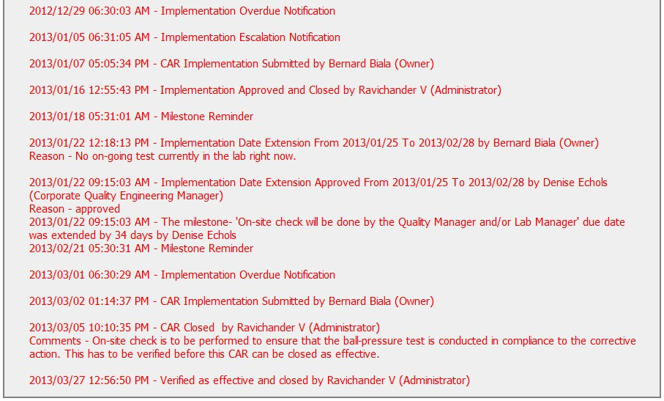
CAR Admin took immediate action to close the CAR.

